Slide 1
The Restaurant
GOAL multi agents system
Habibu Mukhandi / Jaime Rios / Doria Saric / Tim Wieschalla
Multiagent System Design - 2017/18 - 06/15/2018

Slide 2
Introduction

Slide 3
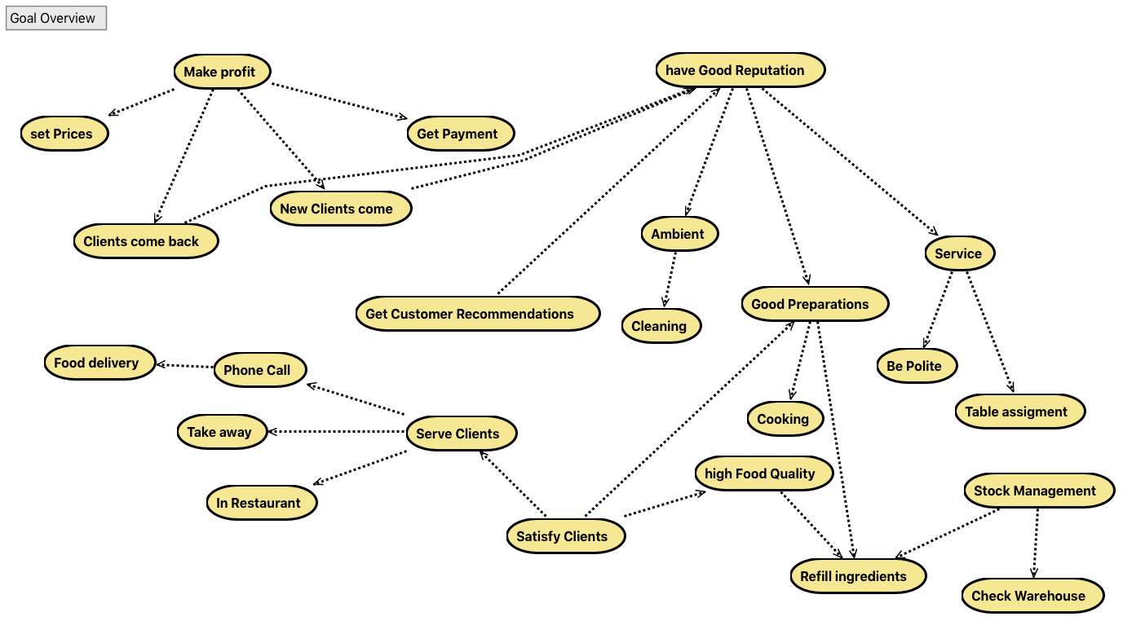
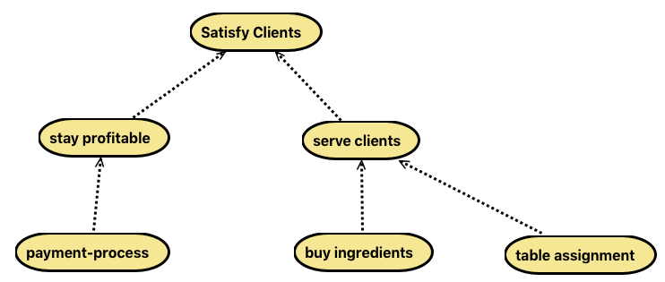
Goal-Overview-Diagram
critics: too high-level
not detailled enough for the prometheus-methodology
improved version
covers our discussed model more appropriate and evades

Slide 4
Goals finals Version
covers our discussed model more appropriate and evades

Slide 5
Goals-Overview

Slide 6
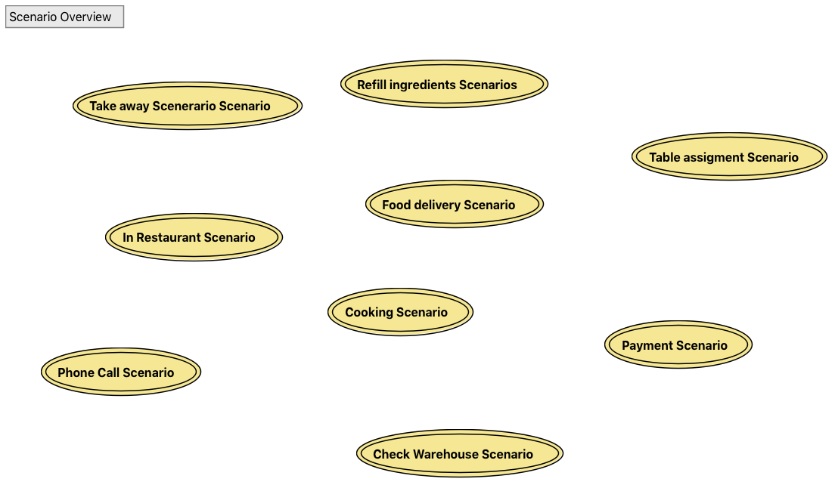
Scenarios

Slide 7
Scenarios

Slide 8
System Role Overview

Slide 9
Agent types

Slide 10
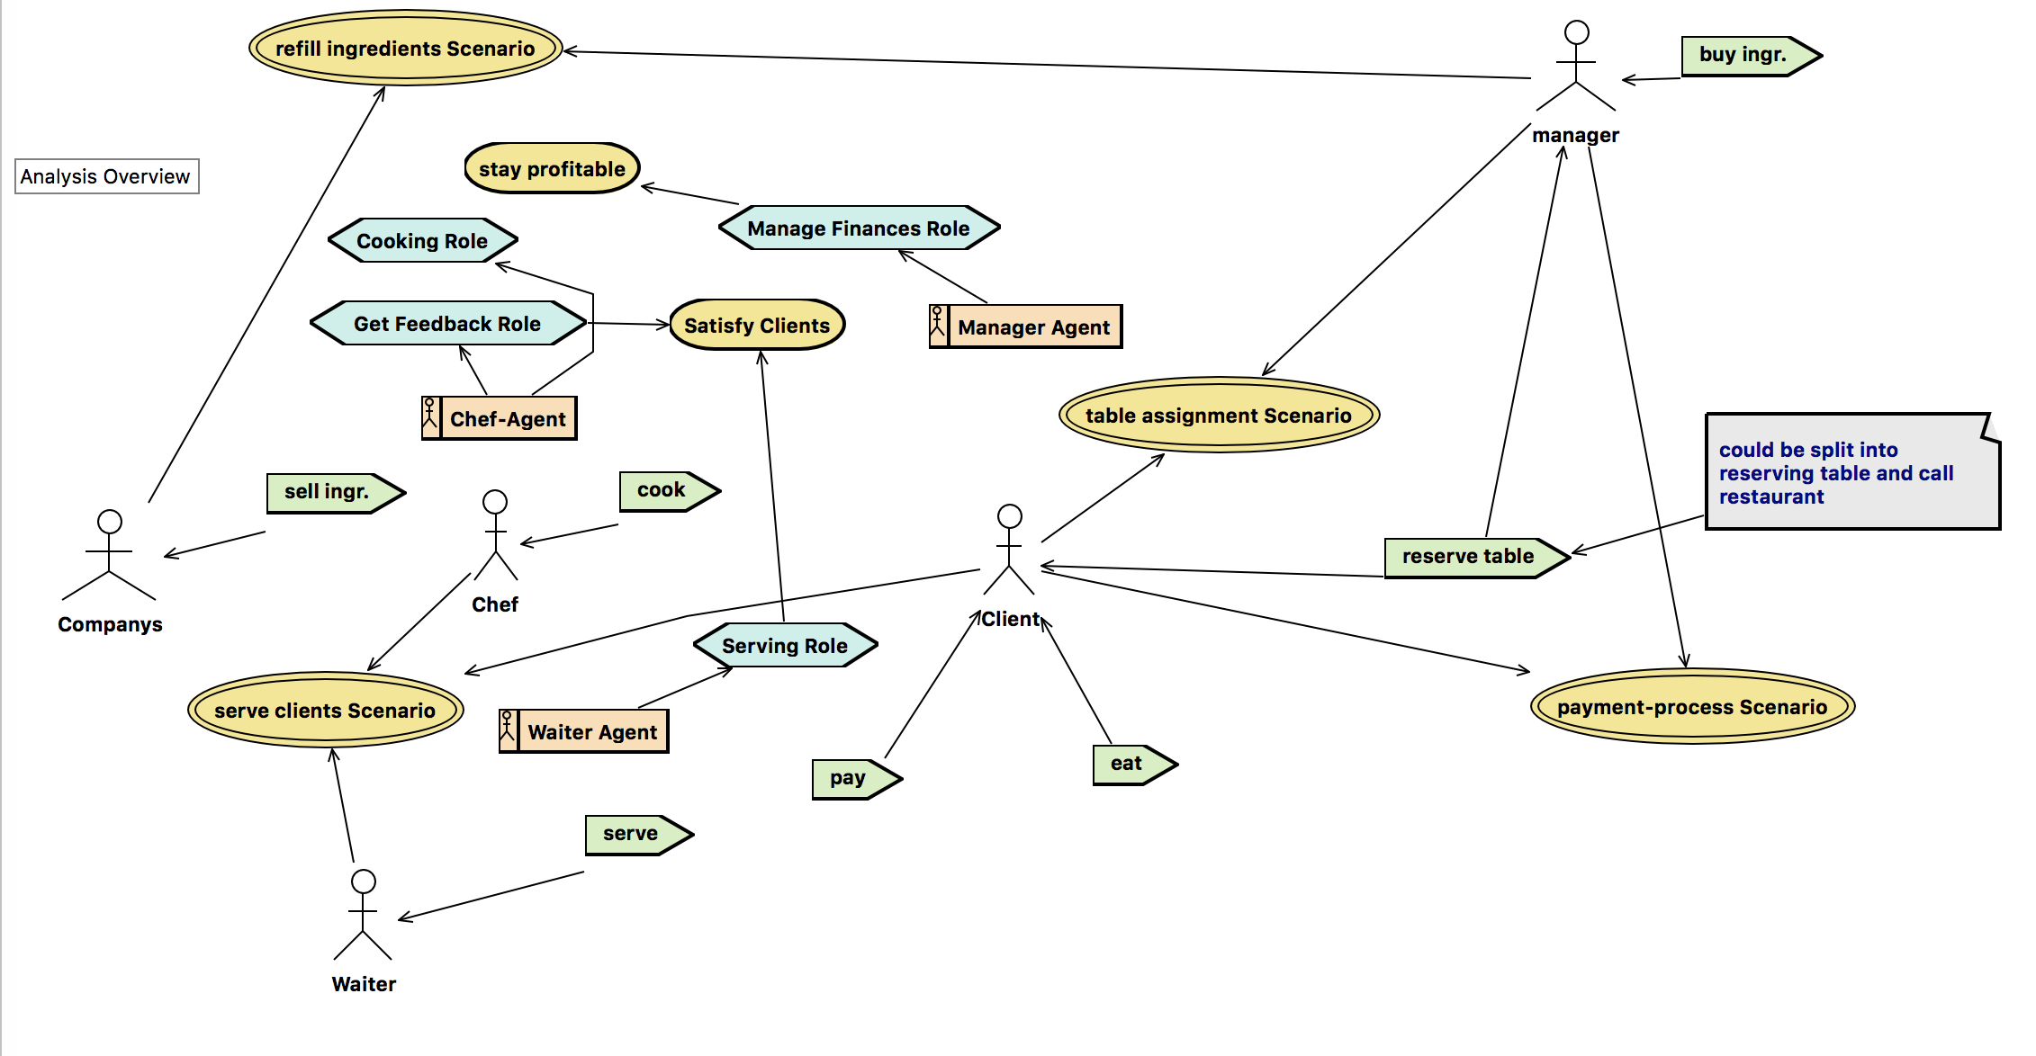
System-Overview

Slide 11
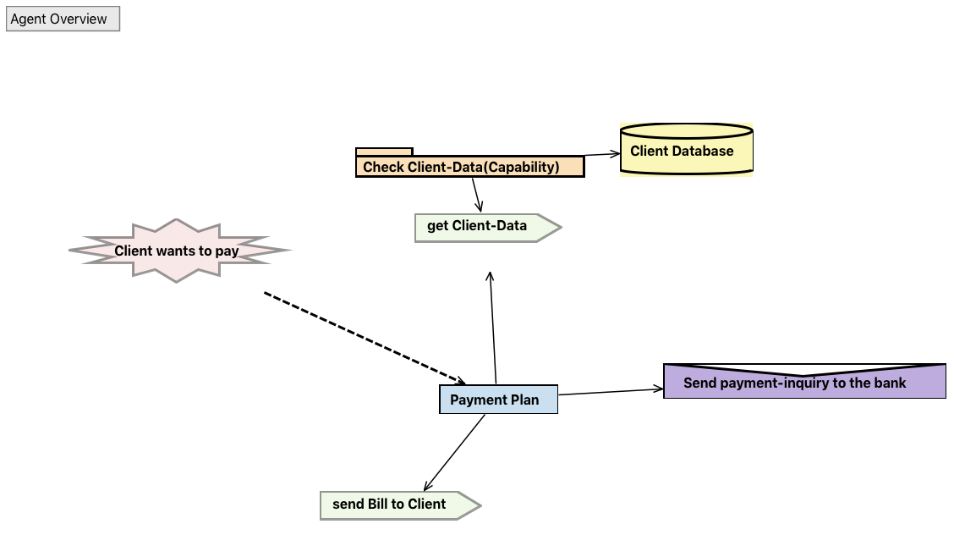
Payment Process

Slide 12
Payment Process(Manager-A.)

Slide 13
Plan-Implementation in Goal

